Slide 1



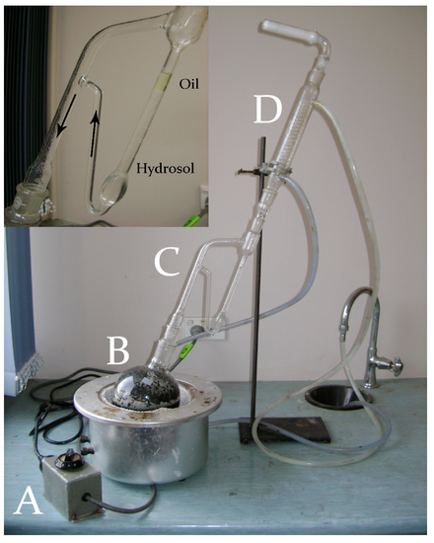
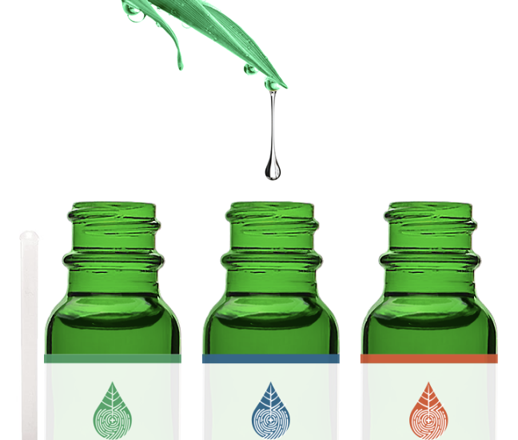
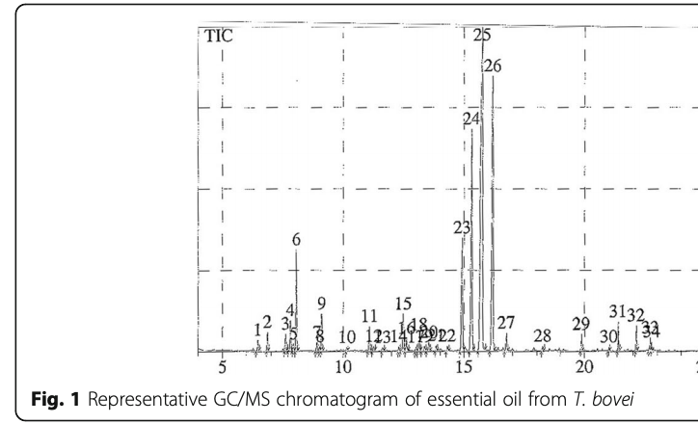
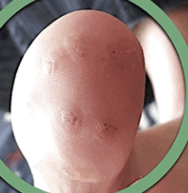
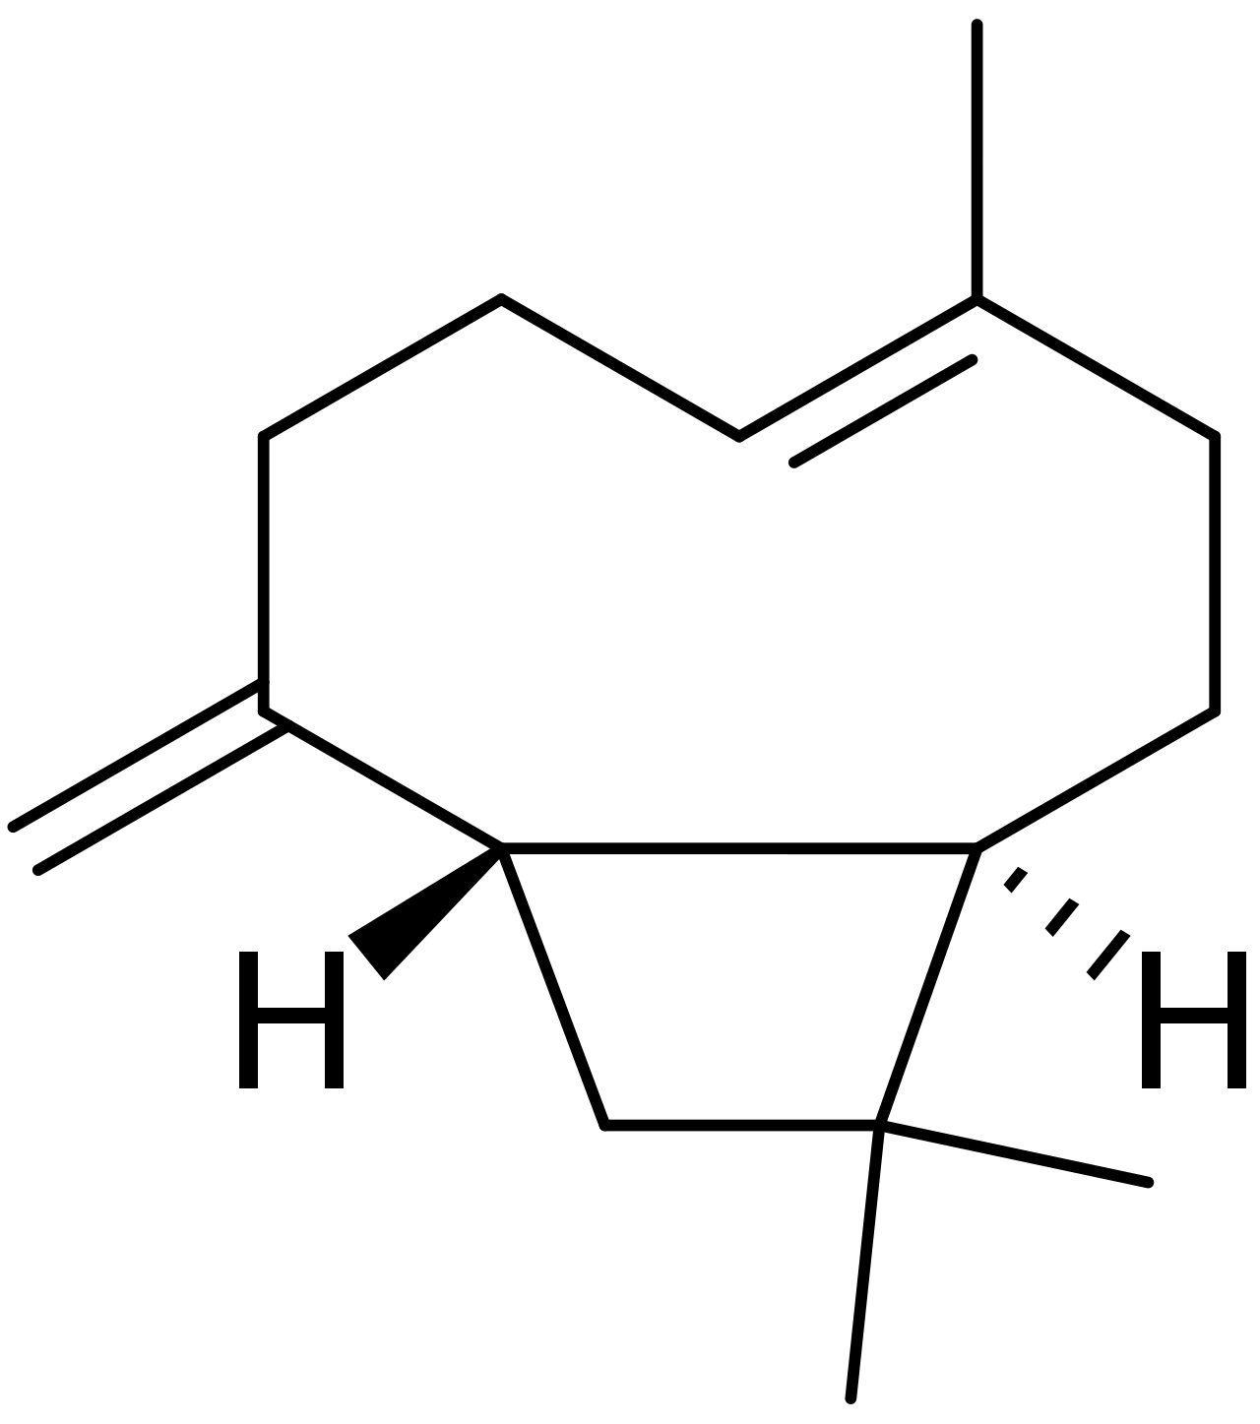
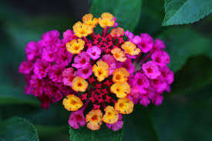

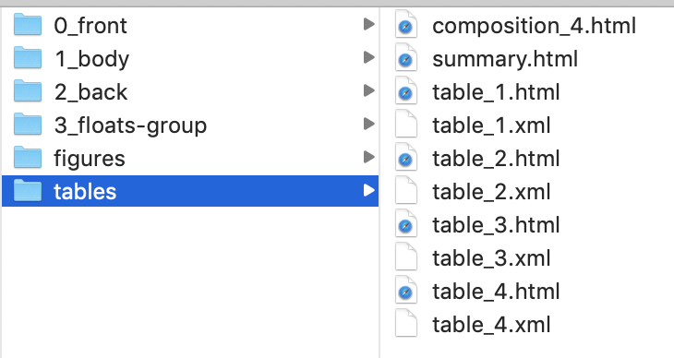
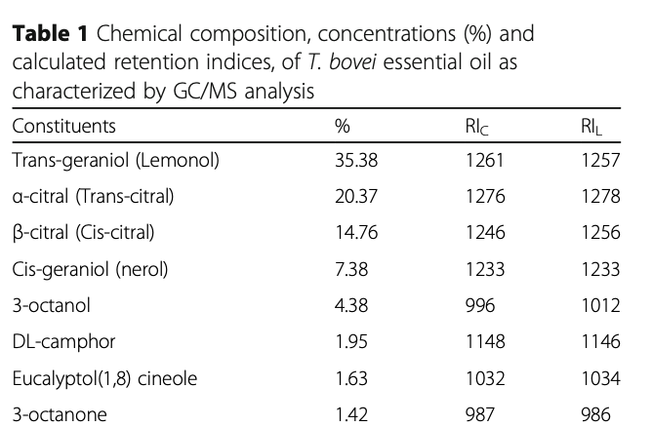
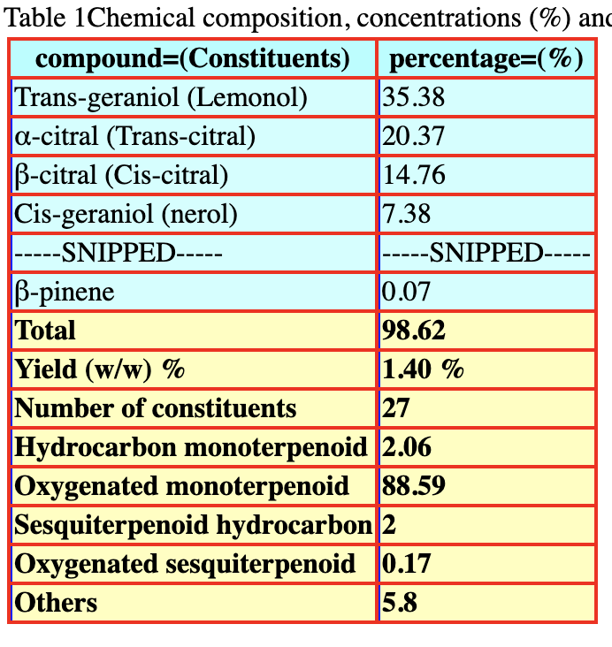
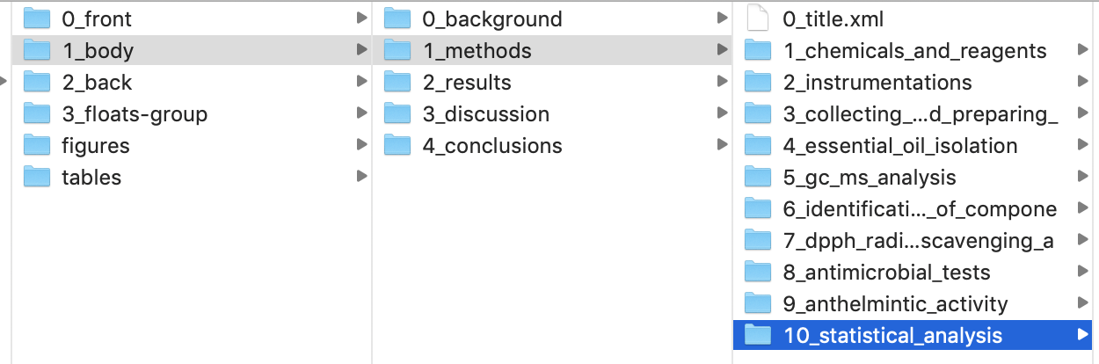
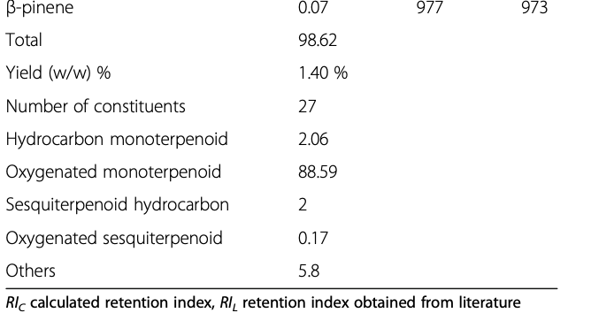
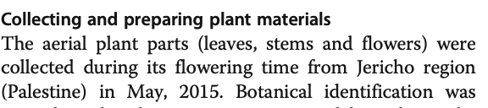
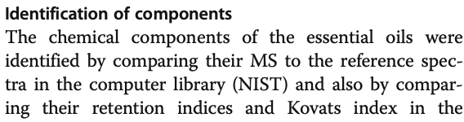
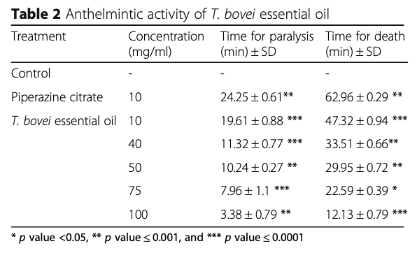
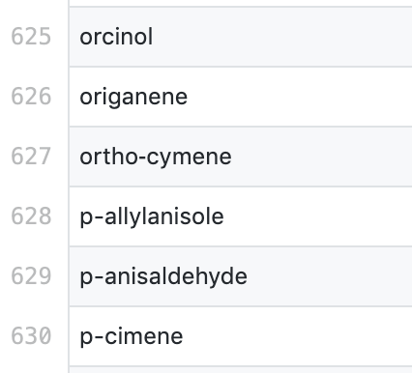
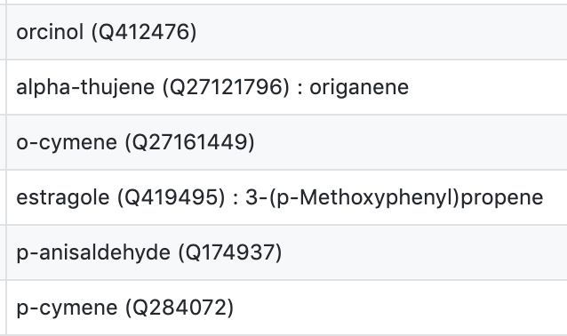
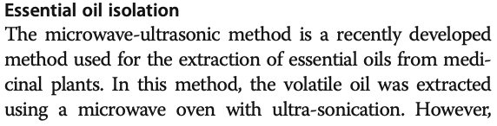
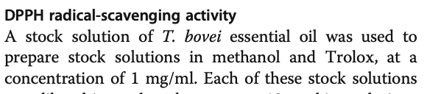
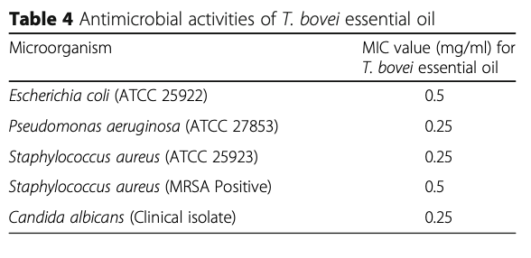
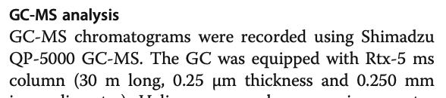
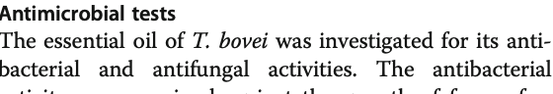
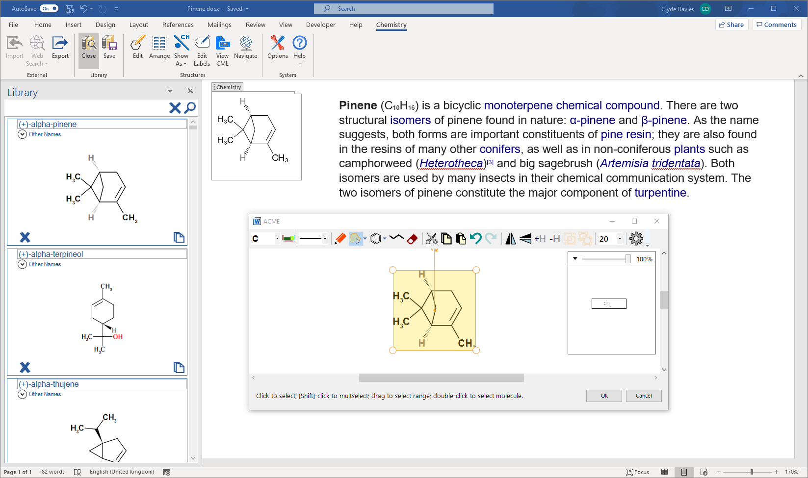
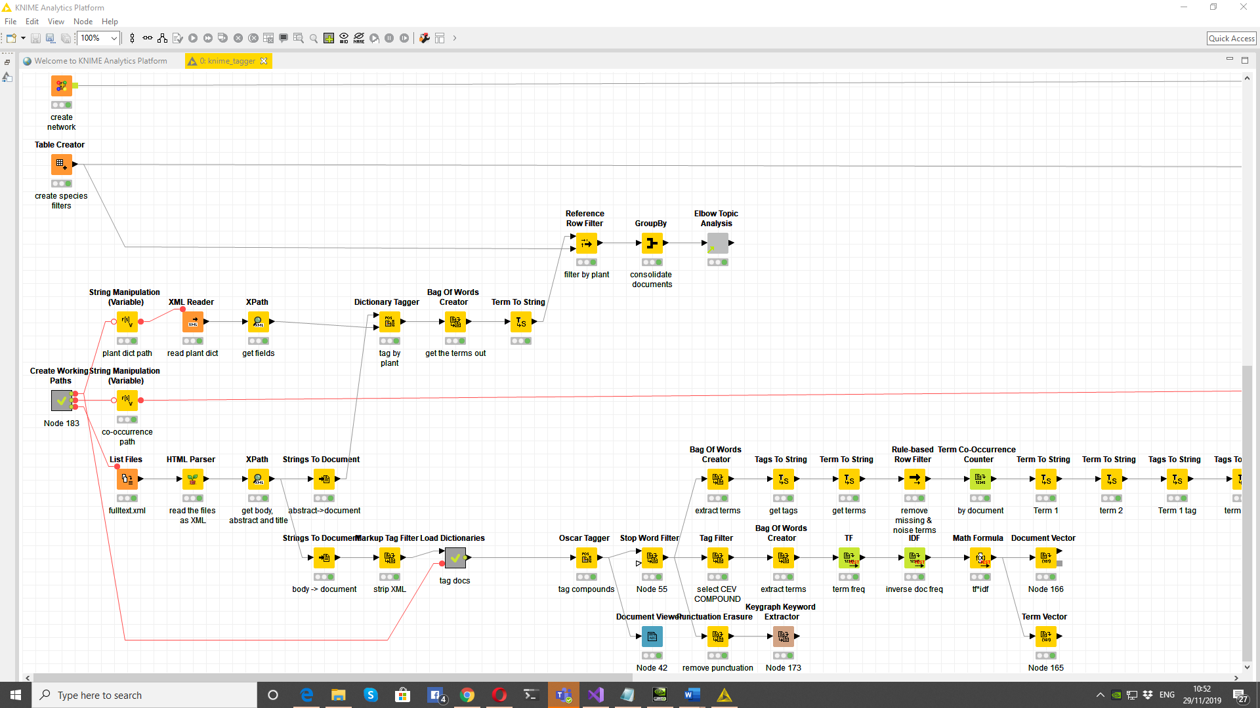
Can machines curate the Open phytochemistry literature?
Clive Adams ⁵, Clyde Davies⁵, Emanuel Faria⁴, Ambarish Kumar¹, P
, Peter Murray-Rust^{2,3, a,} Mike Williams⁵, Andy Wright^{5,} Gitanjali Yadav^{1,2}
¹ National Institute of Plant Genome Research, New Delhi, IN; ² University of Cambridge, UK ; ⁴ Verriclear ; ⁵ Chem4Word; ³ ContentMine Ltd, Cambridge, UK,
16000 Open articles (EuropePMC) report medicinal properties of plant oils. Typical narrative:
Automatically download articles; sectioning, disambiguation; semantics,
100,000 compound references, normalization, to create semantic phytochemical dictionary.
Everything (chemicals, plants, countries, activities, bibliography) is linked to Wikidata
leaf Q33971
Thymus
vulgaris
steam distillation
(Q1164392)
fruit Q1364
Q3215980
extract
analyze
Test activity
Harvest plant
oil
Q421614
flower Q506
$ getpapers -q "((essential oil) AND ((antimicrobial) OR (antibacterial) OR (antioxidant) OR (antihelmintic)))" -n
Query (2019-11) europepmc.org using ContentMine’s “getpapers” ➔ 16006 open access results (EuPMCVersion: 6.2)
SEMANTICS: Wikidata (a Wikimedia project) has nearly 70 million items of Open semantic knowledge. Items have unique identifiers (Q numbers) related by properties (P). Example: “ the invasive species Lantana camara produces beta-caryophyllene” is represented by the triples: Q332469 P5626 “56” (L. camara hasGISDId 56 – (GlobalInvasiveSpeciesDatabase))
Q421614 P1582 Q332469 (beta-caryophyllene isNaturalProductOf L. camara)
We use ContentMine dictionaries to support text-mining … … and text-mining to populate Dictionaries!
Automatic sectioning of article and template-based table extraction
Heuristic template
Automatically identifies columns and head/body/footer
Commonest compounds in 1000 articles
➔
Limonene x 125
α-Pinene x 123
β-Pinene x 118
Linalool x 107
Caryophyllene oxide x 100
β-Caryophyllene x 92
Camphene x 90
Sabinene x 86
γ-Terpinene x 69
➔
Synonyms or isomers?
➔
Caryophyllene x 25
α-Caryophyllene x 9
(E)-Caryophyllene x 7
Isocaryophyllene x 6
Caryophyllene <E-> x 6
(E)-caryophyllene x 5
trans-Caryophyllene x 3
trans-β-caryophyllene x 2
E-Caryophyllene x 2
(E)-β-Caryophyllene x 2
raw
Wikidata lookup
Phytochemical dictionary in Chem4Word
KNIME workflow (part!) for extracting the literature
Queries that CEVOpen/Wikidata can support
How much does the composition of essential oils vary with geography?
Can chemical fingerprints be correlated with medicinal activity ?
Who funds, or is likely to fund, essential oil research?
What new phytochemicals have been reported in 2019 preprints?
Identify plants that produce chemicals similar to known medicinal drugs.
Developments in progress
Integration with KNIME (fingerprints, searching) OSCAR/OPSIN (NLP)
Semantic annotation of articles
Templates for extracting medicinal activity
Checking tables and content for semantic consistency
Synonym resolution and fuzzy chemistry
What would YOU like?
What can you help with?
References and Acknowledgements
ContentMine.org software: http://github.com/contentmine and : http://github.com/petermr/ami3/
https://www.wikidata.org/wiki/Wikidata:WikiFactMine
Images from Wikimedia Commons; Licence CC0 and CC BY-SA
GY, AK, thank NIPGR for financial support.
GY Thanks the DBT-Cambridge program for Funding (University of Cambridge, Dept of Biotechnology, Govt of India)
a: (PMR’s IDs) [Wikidata] : [Q908710] (ORCID) (0000-0003-3386-3972)

